Slide 1
Fundamentals of Model Based Systems Engineering for Life Cycle Management
Testing and validation platforms
Master’s Degree in Smart Energy Systems

Slide 2
Contents
Introduction.
V-model methodology.
Model-based Systems Engineering.
Tools for Model-based Systems Engineering.
Practical examples of System engineers
System engineering and model based design with Matlab

Slide 3
Introduction
1

Slide 4





Introduction
In research centers and universities we focus on technology development.
University
Company
+
Knowledge
Need/challenge
New technology
New application

Slide 5
Introduction
But, companies sell products ≠ technology.
Product
Customer requirements
Risk management
Validation & Verification
New technology
Sales and marketing strategy
Project management
Regulations, certifications
Post-sales service

Slide 6
Introduction
Industrial companies are responsible for the whole life-cycle of a product.
Customer requirements
Detailed design
System requirements
Someone identifies a need
Concept
System architecture
Implementation
System testing and validation
Subsystem integration
Unit testing
Operation and maintenance
Upgrade and retirement
life-cycle = a series of stages that a product goes through in its life, from conception to retirement
Someone decides that needs a new one

Slide 7
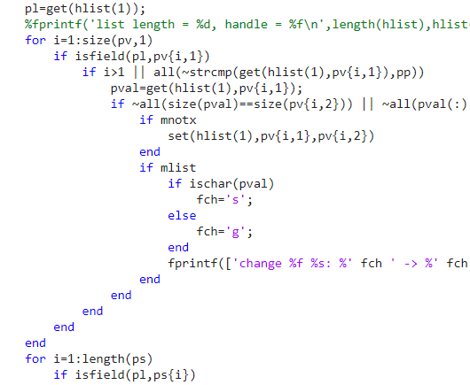
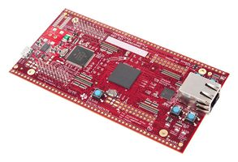
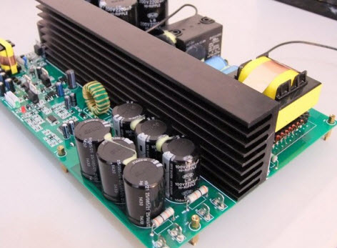
Introduction
Nowadays, systems are complex and their life cycle has several phases.
A typical energy system product is composed of power hardware, control hardware and control software.
Control hardware
+
Control software
+
Power hardware

Slide 8
Introduction
Different methodologies have been proposed to manage the life cycle.
B model
Waterfall

Slide 9
V-model methodology
2

Slide 10
V-model
The reference methodology in this course will be the V-model.
From conception to retirement
1st branch
top down
2nd branch
bottom up
Time axis is vended to form a V, each phase in the left has a counterpart in the right

Slide 11
V-model (decomposition and design)
Someone has an idea about a product or a service. Writes down how the product or service should be.
The developer writes down the needs and the operation environment in collaboration with the customer.
What the customer is looking for is interpreted and translated into technical requirements to be followed during the design of the system.
A high-level architecture is defined in order to fulfil system requirements.
Design of subsystems and components.

Slide 12
V-model
Software and Hardware Development. Select appropriate technology and develop software and hardware to meet component-level requirements.
So far, you are experts on this. You are used to:
Design/simulate components (electronics, storage systems, control, systems…).
Implement components (build PCBs, write code, test control boards,…).
Test components.

Slide 13
V-model (Validation and verification)
User support and maintenance operations
(Smart monitoring subject)
This is the tricky part. Think how your student project went in this phases!
All subsystems are integrated to form the final system. System tests are performed and validation is done against system requirements.
Integrate software and hardware components to create subsystems verifying their correct operation at subsystem level.
Test each hardware and software component, verifying their correct operation at unit level.

Slide 14
V-model (Validation and verification)
validation ≠ verification
Verification: Are we developing the product correctly? Ensure that the system is well designed, safe and functions correctly.
Validation: Are we developing the right product? Evaluates how well the product solves the customer's problem. Validation is always done against requirements.

Slide 15
V-model (Validation and verification)
validation ≠ verification
Verification: Involves two consecutive phases.
Validation: Involves parallel phases

Slide 16
Example. V-model (Validation and verification)
validation ≠ verification
Involves parallel phases
Involves two consecutive phases.
id | Tasks | Verification | Validation | Notes
1 | Inspection check to see if electric scooter is ready to test driving
2 | Compile test results and write documentation showing fulfilment of safety requirements
3 | Participation in workshop to define requirements and standards
4 | Control that all safety requirements are included in the design documents
5 | Detailed inspection of quality according to design documents

Slide 17
V-model for complex systems
When developing a complex system, the V-model can be extended.

Slide 18
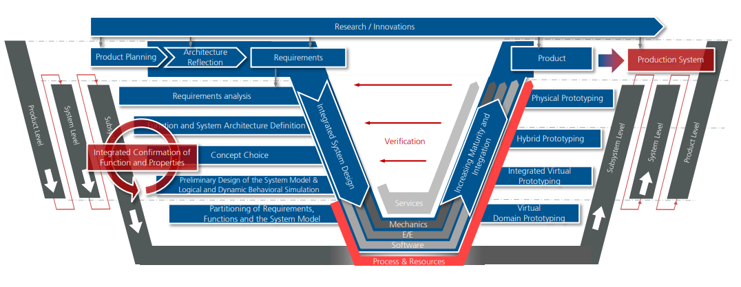
V-model for complex systems
When developing a complex system, the V-model can be extended.

Slide 19
Model-based Systems Engineering
3

Slide 20

Model-based Systems Engineering
Until a few years ago, the V-model was a document centric approach.
Requirements document
Architecture document
Document-centric
The output document of a phase is the input for the next one.

Slide 21
Model-based Systems Engineering
Typical document list in the whole life-cycle
Phase | Sub-phase/Sub-system | Title
Concept | System | System specification
Requirements | System | System requirements
 | Software | Software requirements
 | Hardware | Hardware requirements
Architecture | System | System architecture
 | Software | Software architecture
 | Hardware | Hardware architecture
Implementation | System | System implementation
 | Software | Software implementation
 | Hardware | Hardware implementation
 |  | Bill of materials
 |  | Schematics
 |  | PCB design
Verification and validation | Software | VVT test specification
 |  | VVT test results
 | Hardware | VVT test specification
 |  | VVT test results
 | System | VVT test specification
 |  | VVT test results
 |  | Certification

Slide 22
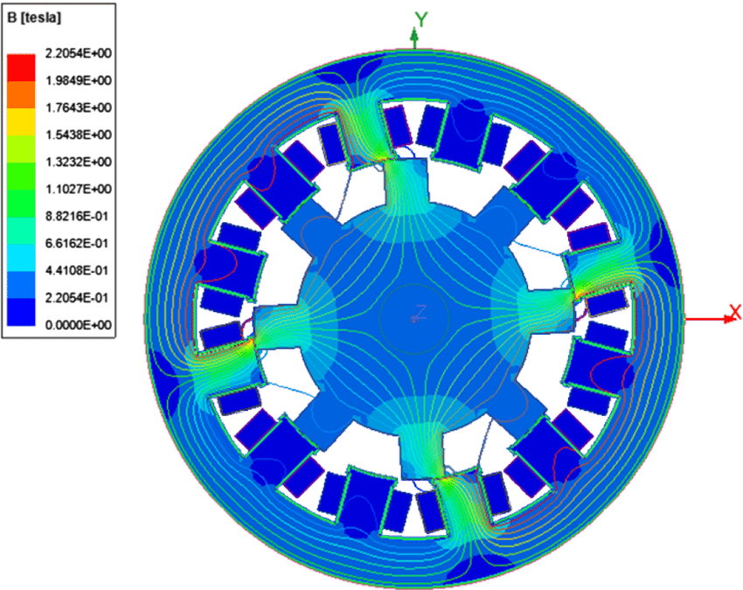
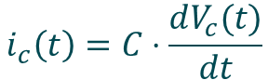
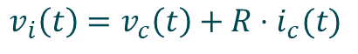
Model-based Systems Engineering
But, models are being used more and more.
model = physical, mathematical or logical representation of a system
$$i_{c}\left(t\right)=C⋅\frac{dV_{c}(t)}{dt}$$
$$v_{i}\left(t\right)=v_{c}\left(t\right)+R⋅i_{c}(t)$$

Slide 23
Model-based Systems Engineering
Examples of models used in the life cycle.
System architecture model in MATLAB & Simulink

Slide 24
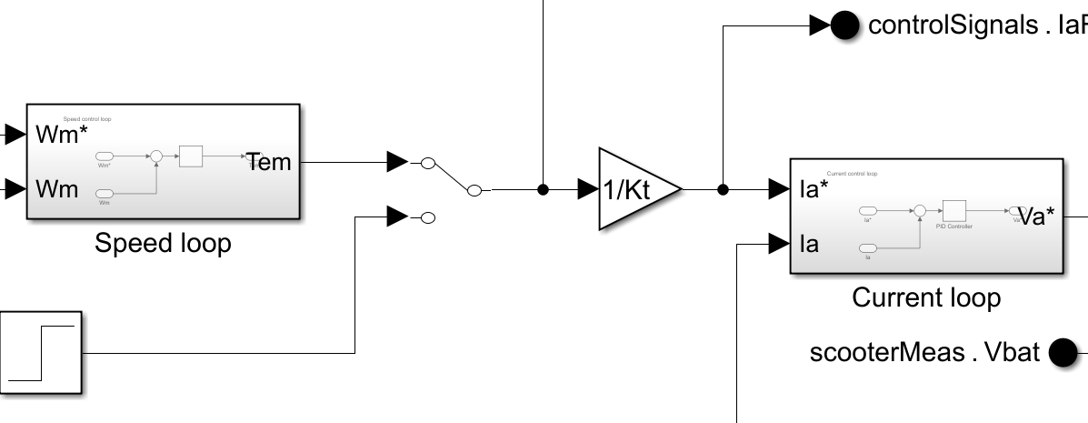
Model-based Systems Engineering
Examples of models used in the life cycle.
Detailed design

Slide 25
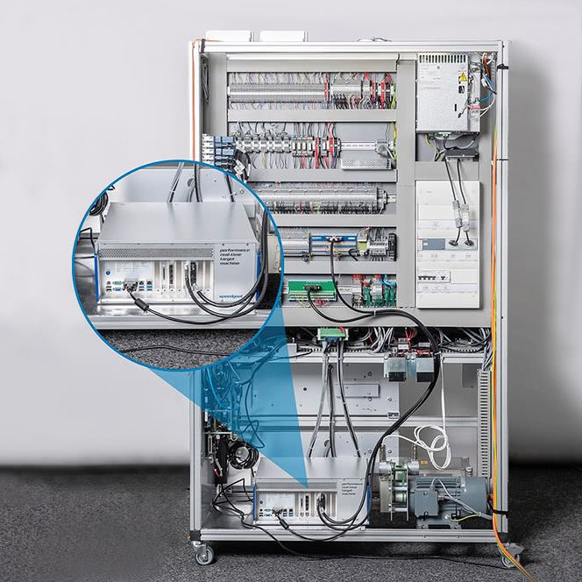
Model-based Systems Engineering
Examples of models used in the life cycle.
Elevator real time simulation platform
https://www.speedgoat.com/success-stories/speedgoat-user-stories/schindler-elevator-corporation

Slide 26
Model-based Systems Engineering
From the use of models, Model-based Systems Engineering (MBSE) has emerged.
MBSE = the formalized application of modelling to support system requirements, design, analysis, verification and validation activities
model

Slide 27
Model-based Systems Engineering
The advantages of MBSE are:
Improvement of communication in multidisciplinary teams. Many people, one model.
It allows companies to design and simulate their products before manufacturing them or having prototypes.
MBSE makes it possible to analyse and advance decisions that would previously have been taken on the basis of prototypes.
It facilitates the management of system complexity.
Documents can be generated automatically from the model, making their maintenance easier and reducing costs and effort.

Slide 28
Tools for Model-based Systems Engineering
4

Slide 29
Tools for MBSE
With the extensive use of models, new testing, verification and validation tools have emerged.
X-in-the-Loop platforms
Model-in-the-Loop
(MIL)
Software-in-the-Loop (SIL)
Processor-in-the-Loop (PIL)
Hardware-in-the-Loop (HIL)
Control CHIL
Power PHIL

Slide 30
Model-in-the-Loop (MIL)
All the elements of the system are simulated in PC.
All the elements are represented by models (block diagrams/equations).
Classical simulation.
Use:
Check architecture.
Check functions work properly.
Check detailed design of components.

Slide 31
Software-in-the-Loop (SIL)
All the elements of the system are simulated in PC.
The controller part, software in the product, is coded and embedded in the simulation.
Embedded code

Slide 32
Software-in-the-Loop (SIL)
All the elements of the system are simulated in PC.
The controller part, software in the product, is coded and embedded in the simulation.
Use:
Check code programming.
Check code functional execution.

Slide 33
Processor-in-the-Loop (PIL)
Controller is real hardware board.
Control board is tested against simulated plant (non real time).

Slide 34
Processor-in-the-Loop (PIL)
Controller is real hardware board.
Control board is tested against simulated plant (non real time).
Use:
Check real time execution of code.
Test interfaces and input-outputs.
Check control hardware-software integration.

Slide 35
Control Hardware-in-the-Loop (CHIL)
Controller is real hardware board.
Control board is tested against simulated plant (RT HIL) .
Controller works as in real product.
real time
real time

Slide 36
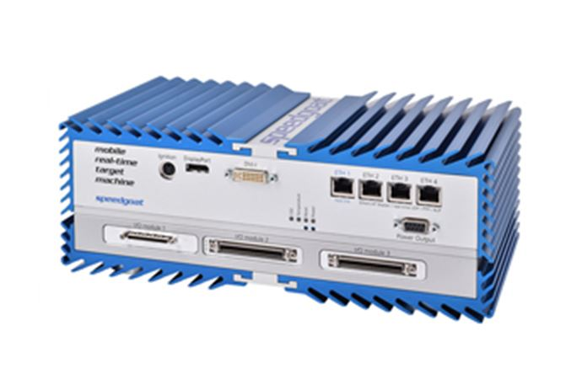
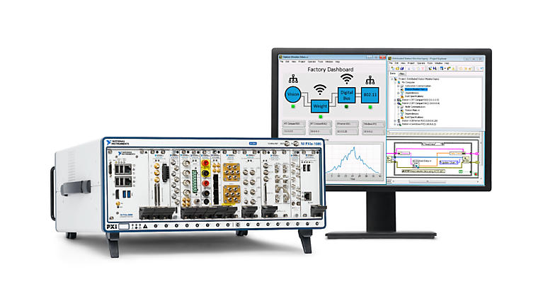
Control Hardware-in-the-Loop (CHIL)
Use:
Check real time execution of code.
Test interfaces and input-outputs.
Check control hardware-software integration.

Slide 37
Power Hardware-in-the-Loop (PHIL)
Use:
Check real time execution of code.
Test interfaces and input-outputs.
Check control and POWER hardware-software integration.

Slide 38
Rapid Control Prototyping (RCP)
Controller is replaced by prototype.
The real system is available and RCP is used while control HW is being developed to test control SW.
Rapid refers to the flexibility to programme the control, usually using MATLAB & Simulink (not in code).

Slide 39
Use cases
“ONLY SOME EXAMPLES “of Mondragon University use cases.
HIL platforms for CHIL demonstrations.
Typhoon HIL based electric scooter HIL.
Speedgoat based electric train HIL.
Labview based elevator HIL.
MIL-SIL-PIL validation process of a temperature estimation algorithm.
Nearby companies
CAFPA HIL developments.
Ingeteam HIL developments.

Slide 40
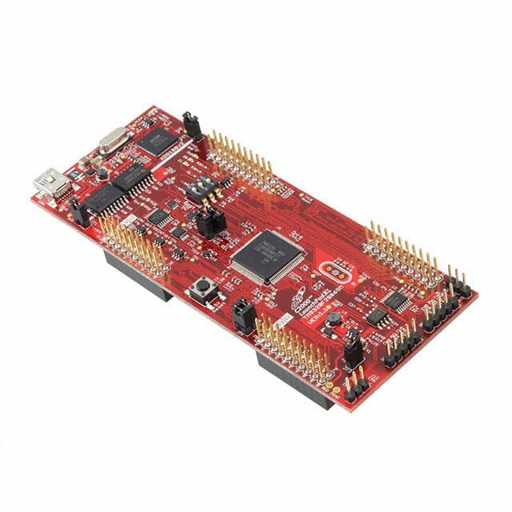
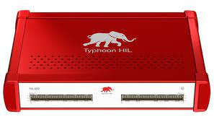
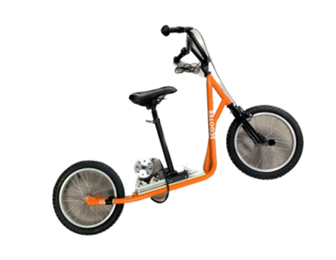
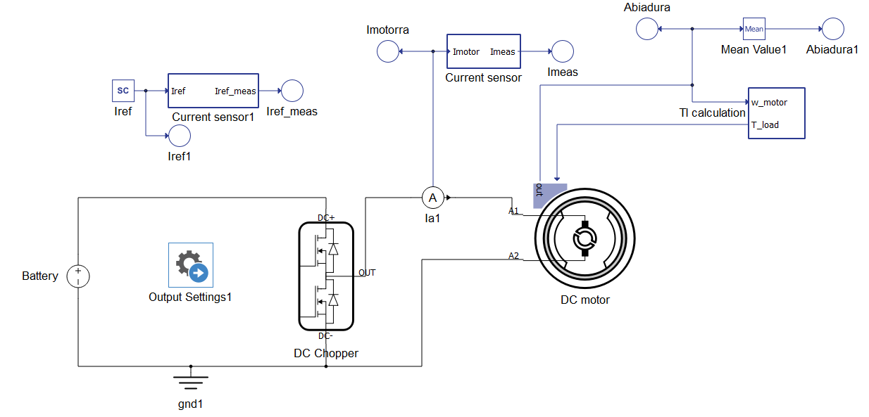
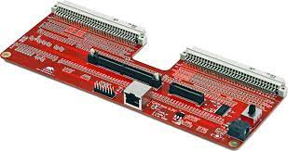
HIL platforms for CHIL demonstrations
Typhoon HIL based electric scooter HIL
Objective
Develop a tool for the validation of electric scooter’s control
Components
Commercial Controller
TI F28379D Launchpad
Real-Time Simulator (HIL 402)
System Plants Electrical & Mechanical system of an scooter and a converter

Slide 41
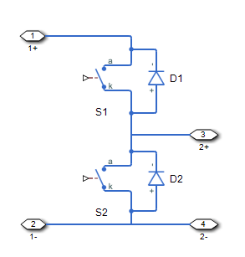
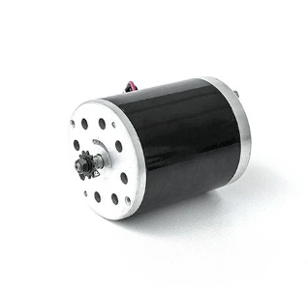

HIL platforms for CHIL demonstrations
Typhoon HIL based electric scooter HIL
Main structure
Micro-controller
HIL
Converter
Motor model
Scooter model
PWM
Feedback

Slide 42
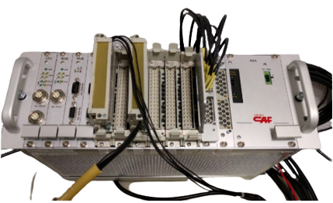

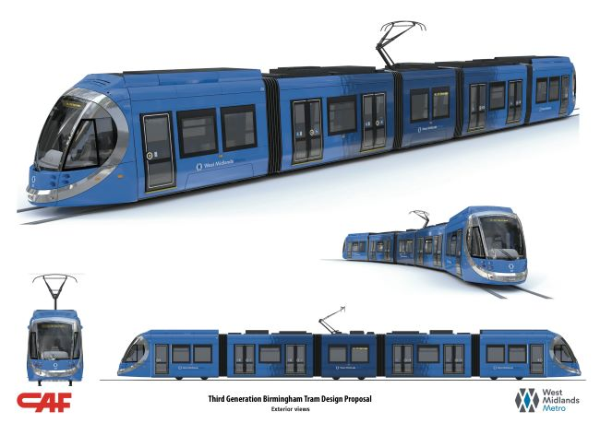

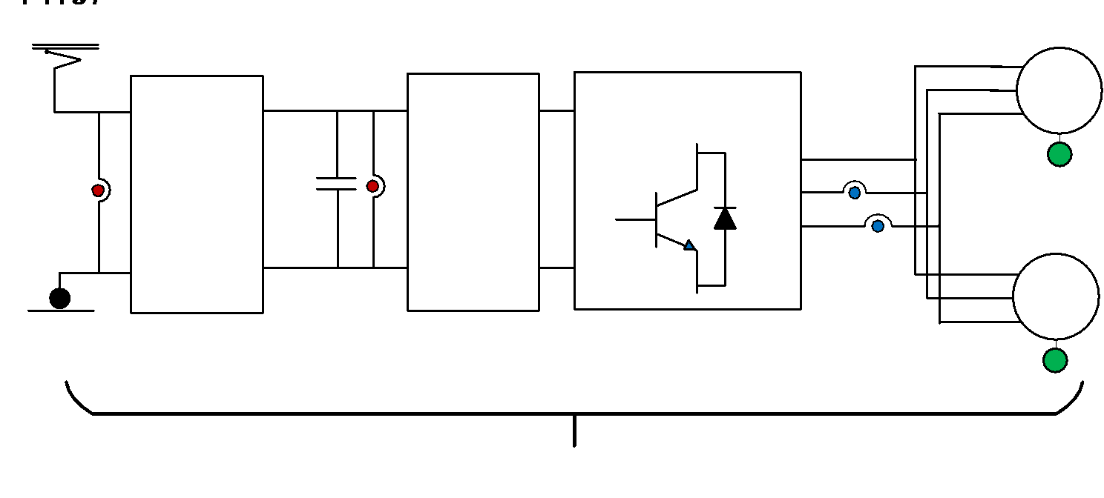
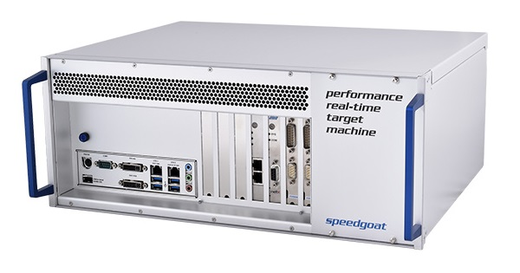
HIL platforms for CHIL demonstrations
Speedgoat based electric train HIL.
Objective
Healthy and Faulty synthetic data generation for system health management strategies.
Components
Commercial Controller
VEGA from CAF P&A company
Real-Time Simulator (SpeedGoat)
System Plant Electric Traction System of a Tram

Slide 43
HIL platforms for CHIL demonstrations
Speedgoat based electric train HIL.
Main structure

Slide 44
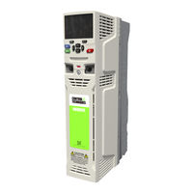

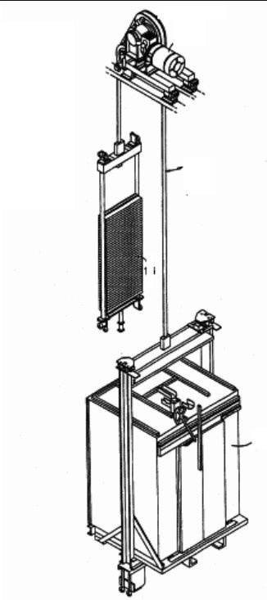
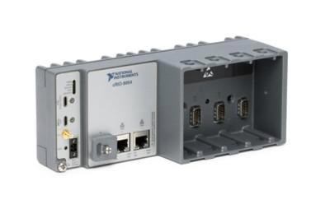
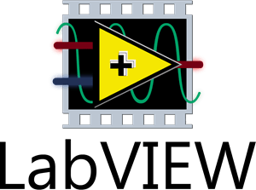
HIL platforms for CHIL demonstrations
Labview based elevator HIL.
Objective
Develop a tool for the validation of vertical drives (lifts).
Components
Commercial Controller
Unidrive M701 (Control Techniques)
Real-Time Simulator (CompactRio)
System Plants Electrical & Mechanical system of an elevator
ANALYTIC
EQUATIONS

Slide 45
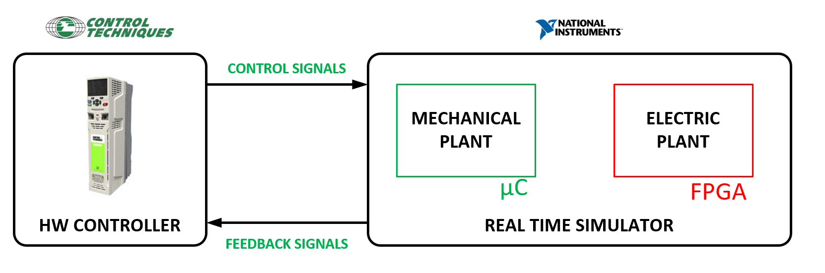
HIL platforms for CHIL demonstrations
Labview based elevator HIL.
Main structure

Slide 46



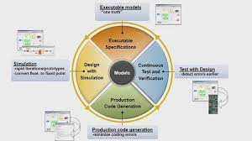

MIL-SIL-PIL validation process of a temperature estimation algorithm
Semiconductor Tj estimation algorithm.
Objective.
Development of a Tj estimation algorithm in a Digital Signal processor DSP of Texas Instruments.
Comparison
Use model based design process MIL-SIL-PIL.
Compare results against a previous developed algorithm in an ARM based Cortex.
MU workflow
Use Matlab based workflow
Compare
Verify
validate
Matlab- Simulink
MIL
SIL-PIL
TOOLS
Matlab- Simulink- Embedded coder
SIL
Matlab- Simulink- Embedded coder
Matlab TI support package
PIL

Slide 47
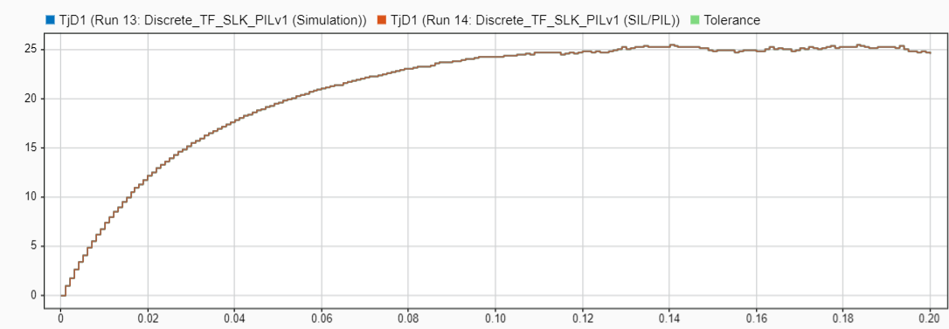
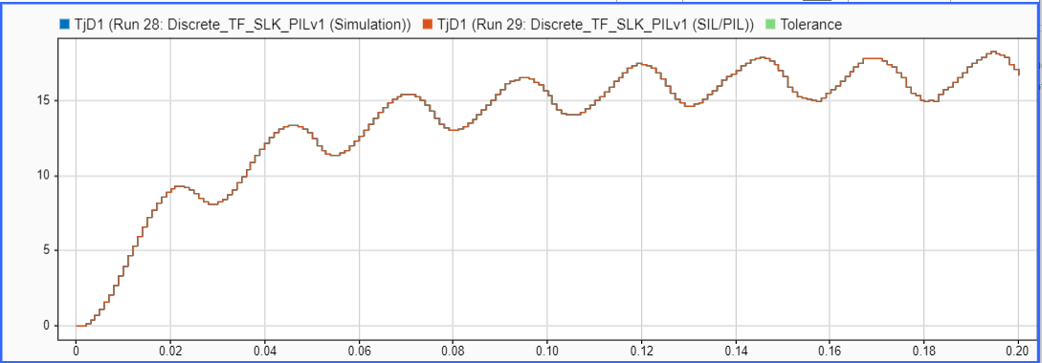
MIL-SIL-PIL validation process of a temperature estimation algorithm
Workflow
12 semiconductors Tj estimation. (6 switches + 6 diodes)
MIL
Compare continuous model vs discretized model
SIL
Generate discretized model in DSP code and run in PC.
PIL
Run DSP code in DSP and stimulate with PC based signals.
Discrete MIL vs PIL results for a step power loss
Discrete MIL vs PIL results for a sinusoidal power los. Equivalent to grid connected or machine connected converter

Slide 48
MIL-SIL-PIL validation process of a temperature estimation algorithm
SIL-PIL Tools
Apart from Embeded coder Matlab has several SIL-PIL tolos
SIL/PIL manager app in Simulink
Numerical equivalence (Compare MIL/SIL/PIL)
Code view (check generated code)
Execution profiling (Time)
Stack profiling (Consumed memory)
Coverage
Main Project result
With automated code generation tools from Matlab and changing from an ARM architecture to a TI DSP based system Mondragon University was able to estimate 12 Junction temperatures with 6 termal RC brances each (72 state variables) in 9.1 μs 3-4 times faster than company code.

Slide 49

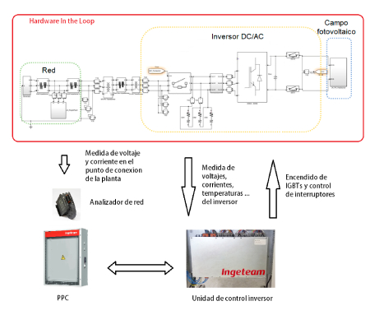
Ingeteam HIL based projects
Ingeteam is developing HIL based power system models for PV, wind, etc for CHIL application.
HIL for wind generation
HIL for PV
Ingeteam CHIL
From control validation, new grid code development and improvement to…
PV Plant aproval! Very interesting.

Slide 50

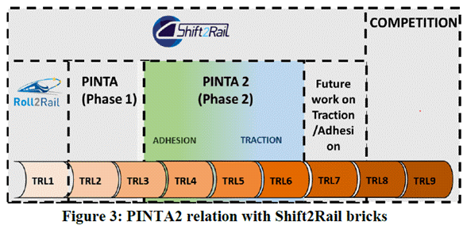
CAFPA HIL Developments
CAFPA is developing HIL platforms for controller validation and continuous improvement since 2008.
Research
Model driven Hardware-in-the-Loop Fault analysis of railway traction systems
A Hybrid Sensor Fault Diagnosis for Maintenance in Railway Traction Drives
Etc, etc
Product validation and homologation (Shift2Rail EU )
Virtual Validation and homologation through HIL environments in traction systems
Virtual validation and certification as goal!

Slide 51
MBSE and simulation tools
In MBSE the V-model and simulation tools are integrated.
MIL: Model-in-the-Loop.
SIL: Software-in-the-Loop.
HIL: Hardware-in-the-Loop.
RCP: Rapid control prototyping.
LAB: Laboratory tests.
SYS: System test/Product tests

Slide 52
Practical examples: System engineer needs
5

Slide 53
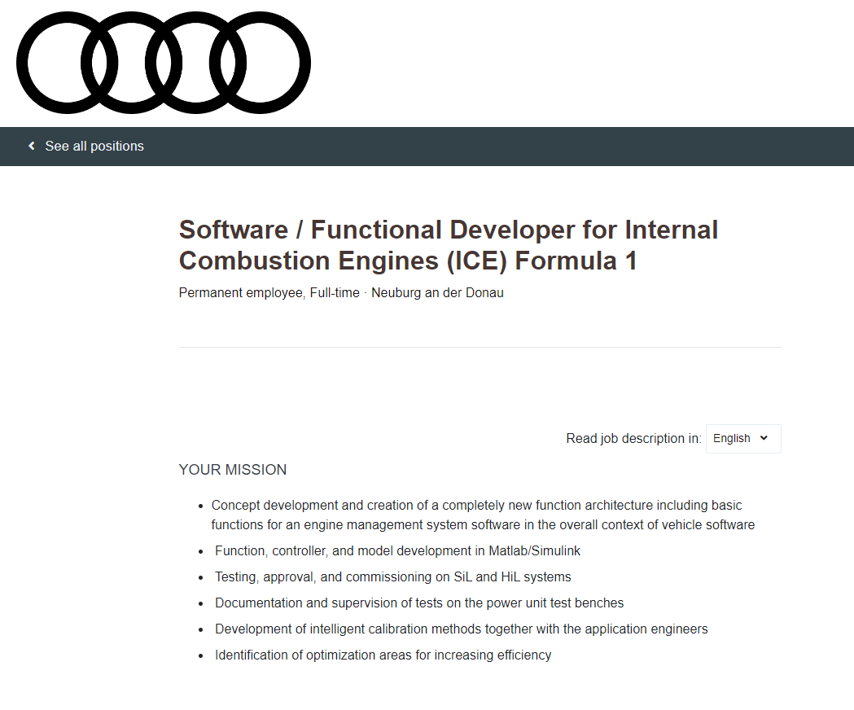
Companies
This may look boring, but companies are looking for people that knows about this.

Slide 54
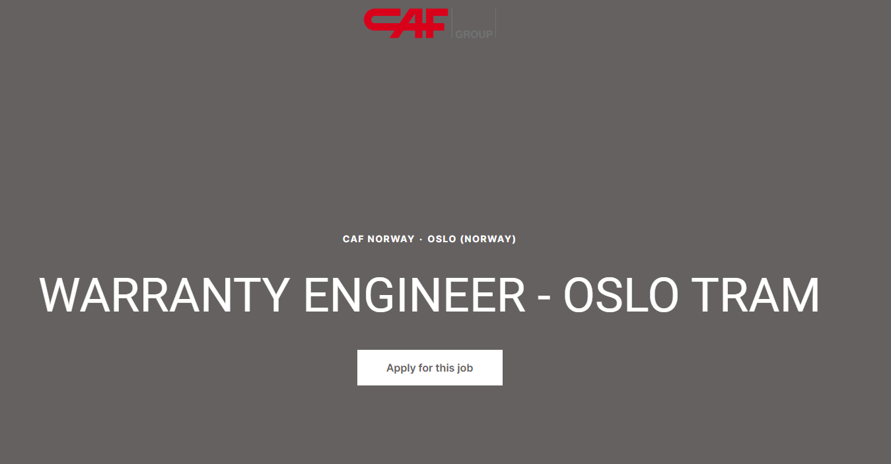
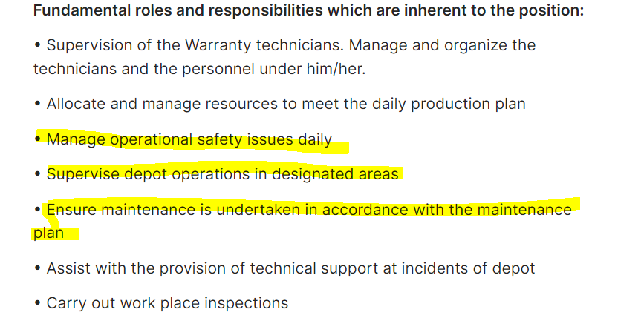
Companies
This may look boring, but companies are looking for people that knows about this.

Slide 55
System engineering and model based design with Matlab
5

Slide 56
V-model and MATLAB & Simulink

Slide 57
Eskerrik asko
Muchas gracias
Thank you
Jon del Olmo Larrañaga
jdelolmo@mondragon.edu
Iosu Aizpuru Larrañaga
iaizpuru@mondragon.edu
Orona Ideo - Fundazioa eraikuntza
Jauregi Bailara, z.g.
20120 Hernani (Gipuzkoa)
Tel. : +(34) 943 739765
www.mondragon.edu

